Slide 1
GPS
(5V in)
Buck converter (7.4V in, 5V out)
USB-C Pigtail
Raspberry Pi 4 (5V in, 5V out)
16 AWG
Jumper
LiPo Battery (7.4V out, 2S)
Tamiya Y Splitter
Compass/ IMU/Gyro
(5V)
Jumper
Motor A (7.4V in)
Motor controller (7.4V in, 7.4V out)
16 AWG
16 AWG
Motor B (7.4V in)
16 AWG

Slide 2
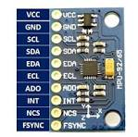
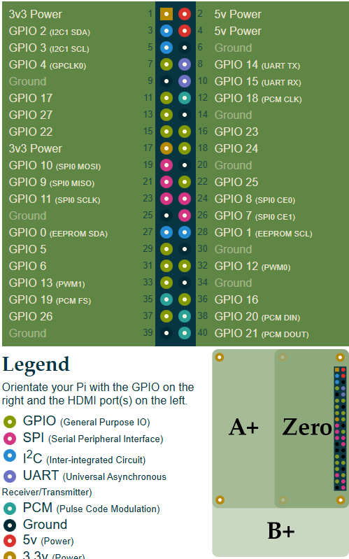
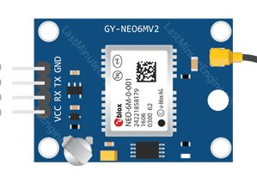
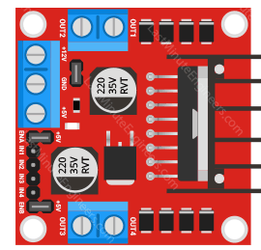
Pi
MPU-9250
GY-NEO6MV
L298

